Slide 1

Brain Tumor Detection and Classification using Convolutional Neural Network
Team Members:
2022PGCSCA087 – Rishav Kumar
2022PGCSCA088 – Samarth Priyadarshi
2022PGCSCA089 – Vipin Pal
Guided By:
Dr. Mayukh Sarkar
Assistant Professor, CSE
Submission Date: 3 Dec 2024

Slide 2
Contents
Introduction
Background
Literature Review
Traditional ML Approach
Proposed Methodology Overview
CNN- Workflow
Data Preparation
Deep Learning Approach
CNN- Architecture
Layers
Detailed View
Training Vs Validation
Implementation Tools
Results – Traditional Classifiers & CNN
Confusion Matrix
Comparative Analysis
Conclusion
References
Future Work

Slide 3
Introduction
Brain tumors are among the most severe health challenges, requiring precise and timely diagnosis.
Manual detection is time-intensive and prone to errors.
This project uses CNNs for automated detection and classification of brain tumors, leveraging MRI (Magnetic Resonance Imaging) datasets.

Slide 4
Background
Brain Tumors:
Malignant (cancerous) and Benign (non-cancerous).
MRI is the preferred imaging technique for tumor detection.
Challenges in detection:
Similarity between tumor and normal tissues.
High variability in tumor size, shape, and intensity.
Role of MRI:
Non-invasive imaging technique critical for diagnosis.

Slide 5
Literature Review
Existing approaches:
Mathematical Morphology + Fuzzy C-Means
Good segmentation but limited classifier accuracy.
Traditional Machine Learning (SVM, KNN)
Dependence on manual feature extraction.
Deep Learning (CNN):
Automated feature extraction with better accuracy.
Research gap:
Need for a robust, scalable, and highly accurate automated detection system.

Slide 6
Traditional Machine Learning Approach
Segmentation:
Fuzzy C-Means clustering to separate tumor regions.
Feature Extraction:
Texture Features: Homogeneity, Energy, ASM, etc.
Statistical Features: Mean, Entropy, Standard Deviation.
Classifiers Used: SVM, KNN, Logistic Regression, Naïve Bayes, Random Forest

Slide 7
Proposed Methodology Overview
Steps:
Data preprocessing: Loading and cleaning MRI datasets.
Model training: CNN with layers for feature extraction and classification.
Evaluation: Accuracy, precision, recall, F1-score for performance metrics.

Slide 8
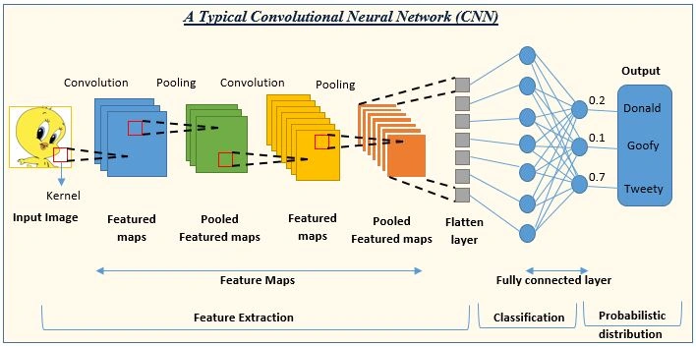
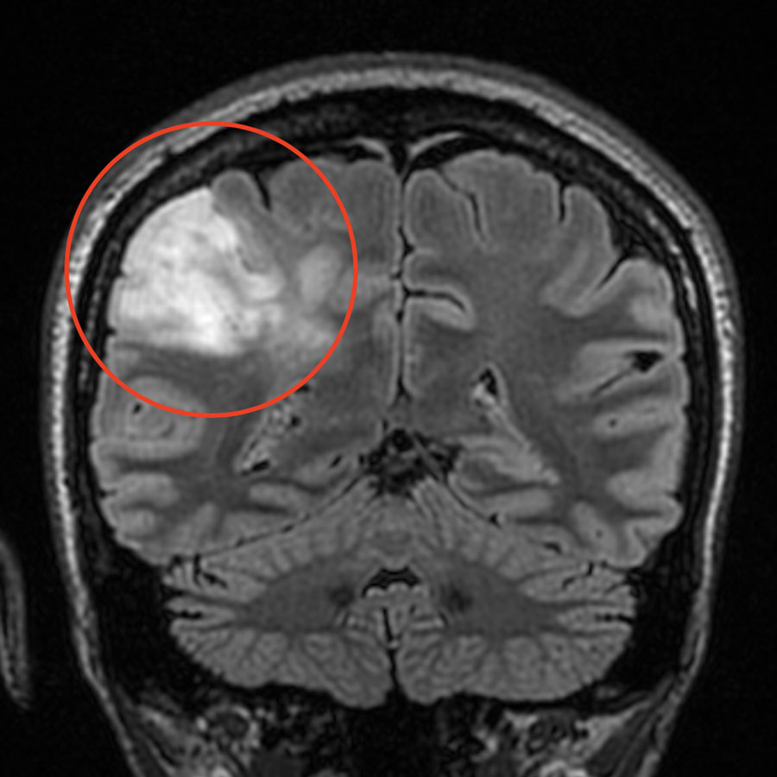
CNN Workflow
Benign
Menin Glioma
Pituitary

Slide 9
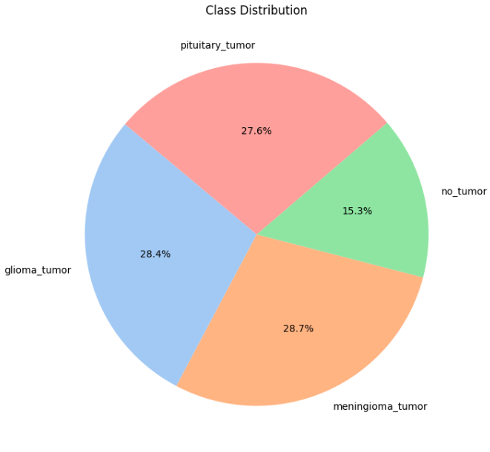
Data Preparation
Dataset Details:
MRI images organized into pituitary tumor, meningiomas,
gliomas and non-tumor classes.
Preprocessing Steps:
Image resizing: All input images to 150x150 to match the model's input layer.
Dataset Spitting : Divide the dataset into training and testing sets with a 90:10 ratio for model training and evaluation.

Slide 10
Deep Learning Approach
Layers:
Convolution layer with 3x3 kernels and ReLU activation.
MaxPooling layer to reduce dimensionality.
Flattening layer for input to dense layers.
Two dense layers for classification with ReLU and Softmax activations.
Training Details:
Optimizer: Adam
Loss function: Categorical Cross-entropy
Epochs: 100, Batch size: 32 (default)

Slide 11
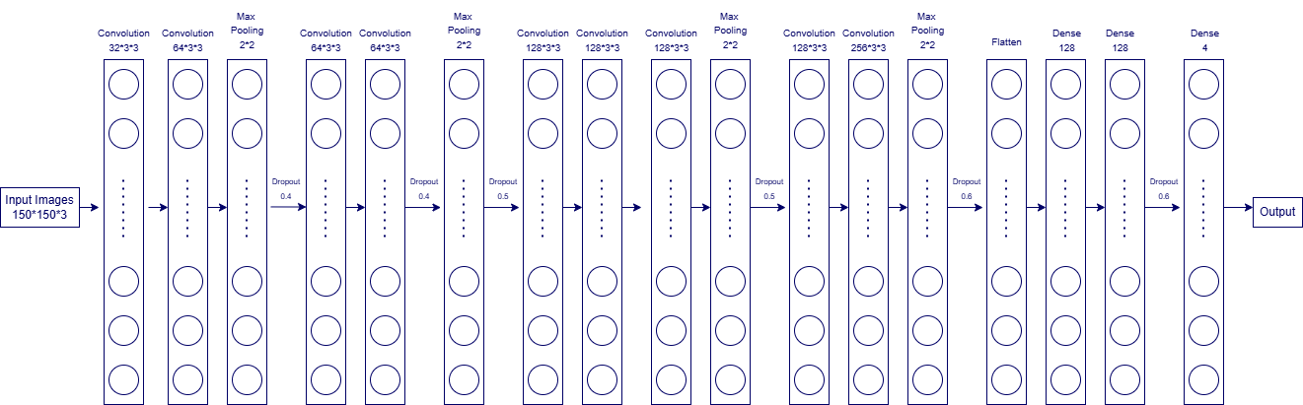
CNN - Architecture

Slide 12
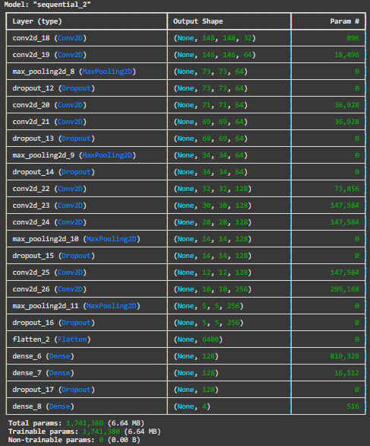
Layers

Slide 13
Detailed View
Input Layer:
Accepts images of size (150x150x3) (RGB format).
First Convolutional Block:
Layers: 2 Conv2D, MaxPooling2D, Dropout (40%).
Purpose: Extract basic features like edges and corners.
Second Convolutional Block:
Layers: 2 Conv2D, MaxPooling2D, Dropout (40% and 50%).
Purpose: Detect patterns and refine feature extraction.
Third Convolutional Block:
Layers: 3 Conv2D, MaxPooling2D, Dropout (50%).
Purpose: Extract complex spatial features.

Slide 14
Cont.
Fourth Convolutional Block:
Layers: 2 Conv2D, MaxPooling2D, Dropout (60%).
Purpose: Learn intricate patterns in deeper layers.
Flatten Layer:
Converts 2D feature maps into a 1D vector for classification.
Fully Connected Layers:
Layers: 2 Dense layers (128 neurons), Dropout (60%).
Purpose: Perform high-level reasoning for classification.
Output Layer:
Layer: Dense (4 neurons), Softmax activation.
Purpose: Outputs probabilities for 4 classes
Softmax Activation Converts raw logits into class probabilities that sum to 1.

Slide 15
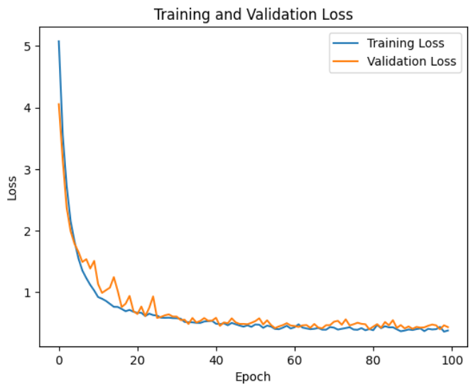
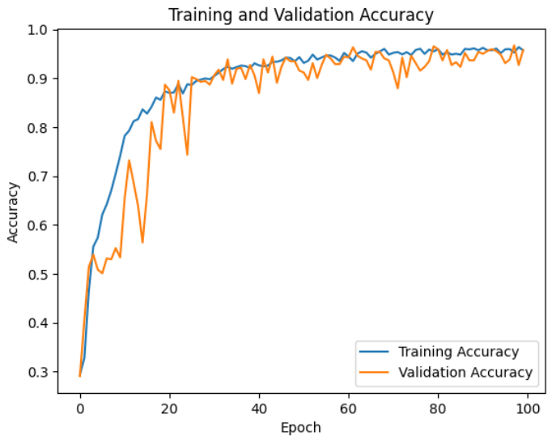
Training vs Validation
Epoch 100 : Training Accuracy : 0.9665 Loss : 0.3611 Val Accuracy : 0.9579 Val Loss : 0.4362
This output shows that the model is performing well with reasonable generalization between training and validation.

Slide 16
Implementation Tools
Tools and Libraries:
Python, TensorFlow, Keras, Scikit-learn, Pandas, Numpy, Seaborn, Matplotlib, cv2
Hardware:
GPU for faster training (NVIDIA).
Software:
Google Collab for coding and experimentation.
Google Drive for Dataset Import

Slide 17
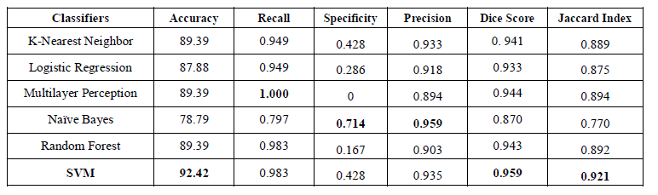
Results - Traditional Classifiers
Best Classifier: SVM with highest precision and recall.

Slide 18
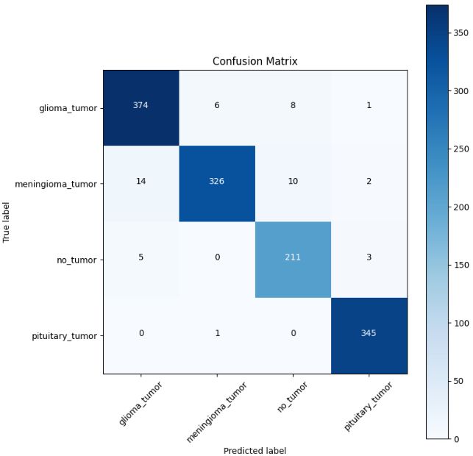
Confusion Matrix

Slide 19
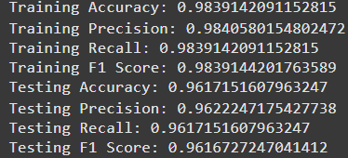
Results - CNN
Performance:
Training vs. testing accuracy: Consistent improvement across epochs.
Advantages:
Automated feature extraction.
Better handling of noisy data.

Slide 20
Comparative Analysis
Traditional methods vs. CNN:
CNN outperforms traditional methods in accuracy and scalability.
Reduced dependency on manual feature engineering.
Accuracy Results:
CNN : 98.39%
SVM: 92.42%
KNN: 89.39%
Random Forest: 89.39%
Logistic Regression: 87.88%

Slide 21
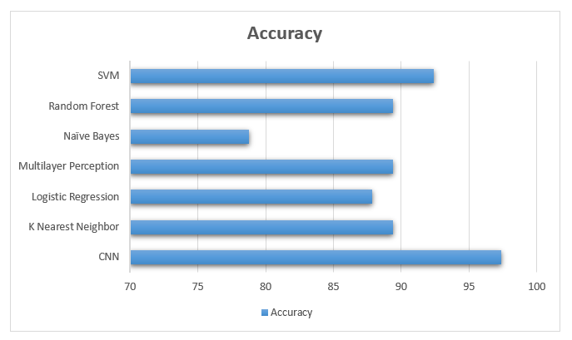
Conclusion
Summary:
CNN achieves superior accuracy (98.39%) compared to traditional classifiers.
Automation improves efficiency in tumor detection.
Impact:
Enhanced diagnosis accuracy with potential for real-time applications.

Slide 22
References
LeCun, Y., Bottou, L., Bengio, Y., & Haffner, P. (1998). Gradient-based learning applied to document recognition. Proceedings of the IEEE, 86(11), 2278-2324.
TensorFlow. (2021). An open-source machine learning framework for everyone. https://www.tensorflow.org/.
Brownlee, J. (2021). How to Develop a Convolutional Neural Network to Classify Photos of Dogs and Cats (from scratch). Machine Learning Mastery. https://machinelearningmastery.com/how-to-develop-a-convolutionalneural-network-to-classify-photos-of-dogs-and-cats-from-scratch/
The pandas development team. (2021). pandas-dev/pandas: Pandas. GitHub Repository. https://github.com/pandas-dev/pandas.
S. S. Keerthi, S. K. Shevade, C. Bhattacharyya, and K. R. K. Murthy. (2001). Improvements to Platt's SMO Algorithm for SVM Classifier Design. Neural Computation,13(3),637–649. https://www.csie.ntu.edu.tw/~cjlin/papers/plattprob.pdf
Abadi, M., Barham, P., Chen, J., Chen, Z., Davis, A., Dean, J., ... & Kudlur, M. (2016). TensorFlow: A system for large-scale machine learning. 12th USENIX Symposium on Operating Systems Design and Implementation (OSDI 16), 265-283.
Keras Team. (2021). Keras. GitHub Repository. https://github.com/kerasteam/keras.
Pedregosa, F., Varoquaux, G., Gramfort, A., Michel, V., Thirion, B., Grisel, O., ... & Vanderplas, J. (2011). Scikit-learn: Machine learning in Python. Journal of Machine Learning Research, 12(Oct), 2825-2830. https://www.jmlr.org/papers/volume12/pedregosa11a/pedregosa11a.pdf
Smith, L. N. (2017). Cyclical learning rates for training neural networks. 2017 IEEE Winter Conference on Applications of Computer Vision (WACV), 464-472. https://arxiv.org/abs/1506.01186
Chollet, F. (2015). Keras. GitHub Repository. https://github.com/fchollet/keras

Slide 23
Future Work
Use of 3D MRI datasets for more comprehensive analysis.
Train on larger datasets to improve generalization.
Deploy as a real-time diagnostic tool integrated with medical systems.
Hyper parameter Tuning
Expanded Classification Capabilities
Integration with Clinical Systems
Performance Optimization
Security and Privacy Measures
Continuous Learning Pipeline
Open-source Collaboration

Slide 24
Q&A
Open for queries and discussions.

Slide 25
Thank You.
Team Members:
2022PGCSCA087 – Rishav Kumar
2022PGCSCA088 – Samarth Priyadarshi
2022PGCSCA089 – Vipin Pal

